Slide 1

Creating Reports in RMarkdown and Quarto

Slide 2
Follow Along in Live Time
Install R and Rstudio to local computer. Instructions
Rmarkdown, install required package: install.packages(“rmarkdown” Alternatively through menu: ‘File -> New File -> R Markdown…’
CCSS Github page with sample code and installation instructions. CCSS Github page.

Slide 3
Differences Between Rmarkdown and Quarto
Rmarkdown
Requires installation
Can only be used within Rstudio
For additional resources for creating slides or websites require installation
Can only create documents through Rstudio.
Quarto
Comes installed default with Rstudio
Can be used with other applications outside of Rstudio
No additional installation needed for creating slides or websites.
Can create document through command prompt

Slide 4
Sample Code and Files
Github Page
Markdown Formatted Text
Code Chunks
Inline Code

Slide 5
References
Rmarkdown introduction
https://rmarkdown.rstudio.com/lesson-1.html
Rmarkdown cheatsheet
https://rstudio.github.io/cheatsheets/html/rmarkdown.html#chunk-options
Quarto introduction. Rmarkdown introduction
https://quarto.org/docs/get-started/hello/rstudio.html

Slide 6
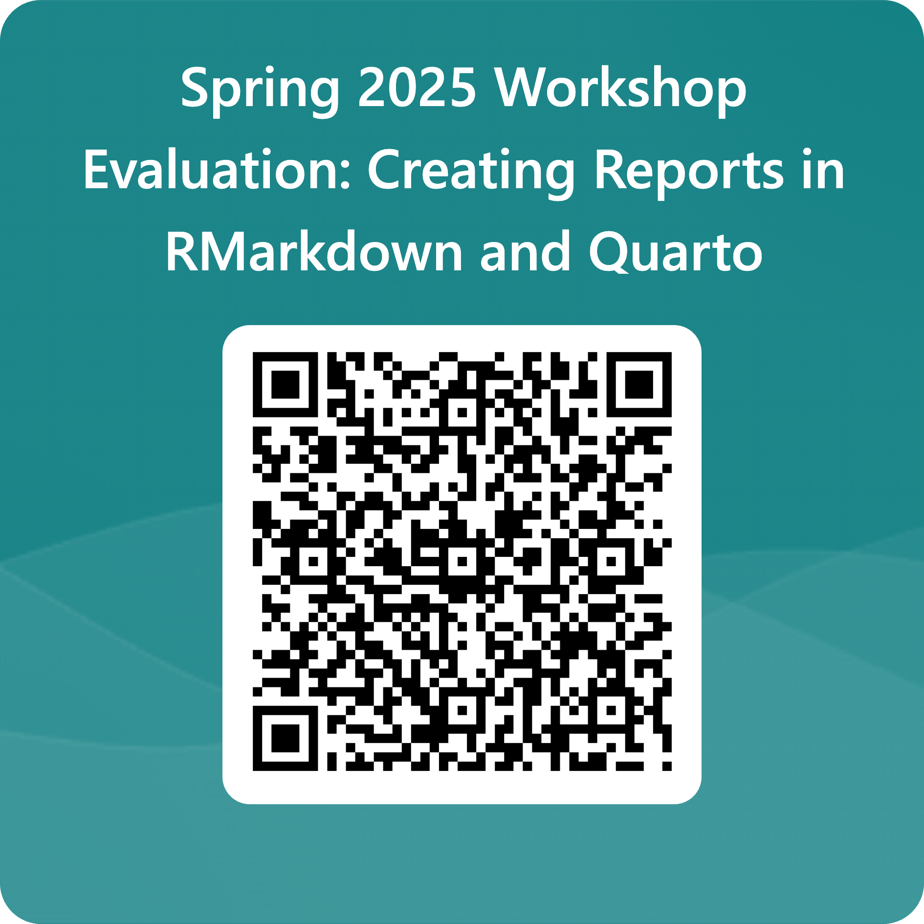
Evaluation

